Slide 1

Intrusion Detection with Snort
Intrusion detection systems (IDS) are crucial for network security. They monitor network traffic for malicious activity. This presentation provides an overview of intrusion detection using Snort. Snort is a powerful open-source IDS/IPS.

Slide 2
Understanding Snort Architecture
Snort's architecture consists of four main components. These include a packet sniffer, preprocessor, detection engine, and output modules. Each component plays a vital role in analyzing network traffic.
Packet Sniffer
Preprocessor
Detection Engine
Output Modules
Captures network traffic for analysis.
Prepares data for the detection engine.
Analyzes traffic based on predefined rules.
Logs and alerts based on detected threats.

Slide 3





Snort Rule Structure: A Deep Dive
Snort rules define how the detection engine identifies malicious traffic. Rules consist of a header and options. Understanding rule structure is crucial for effective intrusion detection.
Rule Header
Defines action, protocol, addresses, and ports.
Rule Options
Includes message, content, and flow.
Examples
Detecting specific attacks.
Best Practices
Minimizing false positives.

Slide 4
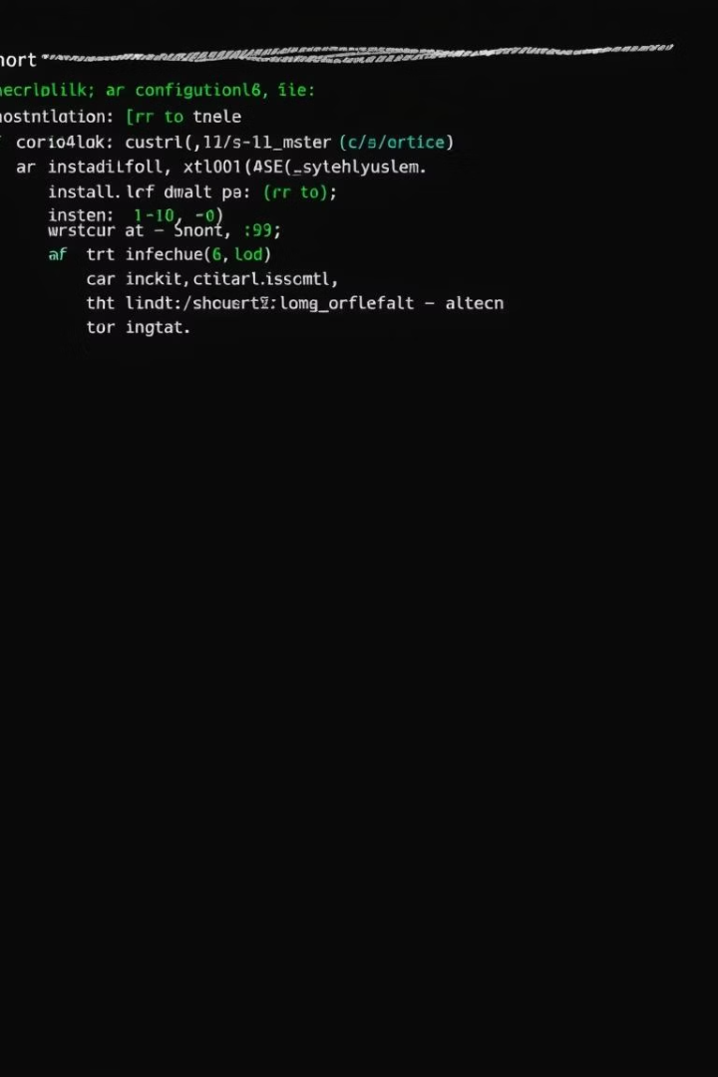
Installing and Configuring Snort
Snort can be installed on various operating systems, including Linux and Windows. Configuration involves setting up the network interface and home network. Proper installation and configuration are crucial for optimal performance.
1
Supported OS
Linux, Windows
2
Installation Steps
Download, compile, install.
3
Configuration Files
snort.conf, snort.rules
4
Basic Config
Network interface, home network.

Slide 5



Snort Preprocessors: Enhancing Detection
Snort preprocessors enhance detection capabilities. They perform tasks such as stream reassembly and HTTP normalization. Preprocessors increase accuracy and reduce false positives.
2
HTTP Normalization
1
Stream Reassembly
DNS Preprocessor
3
Benefits include increased detection accuracy.

Slide 6
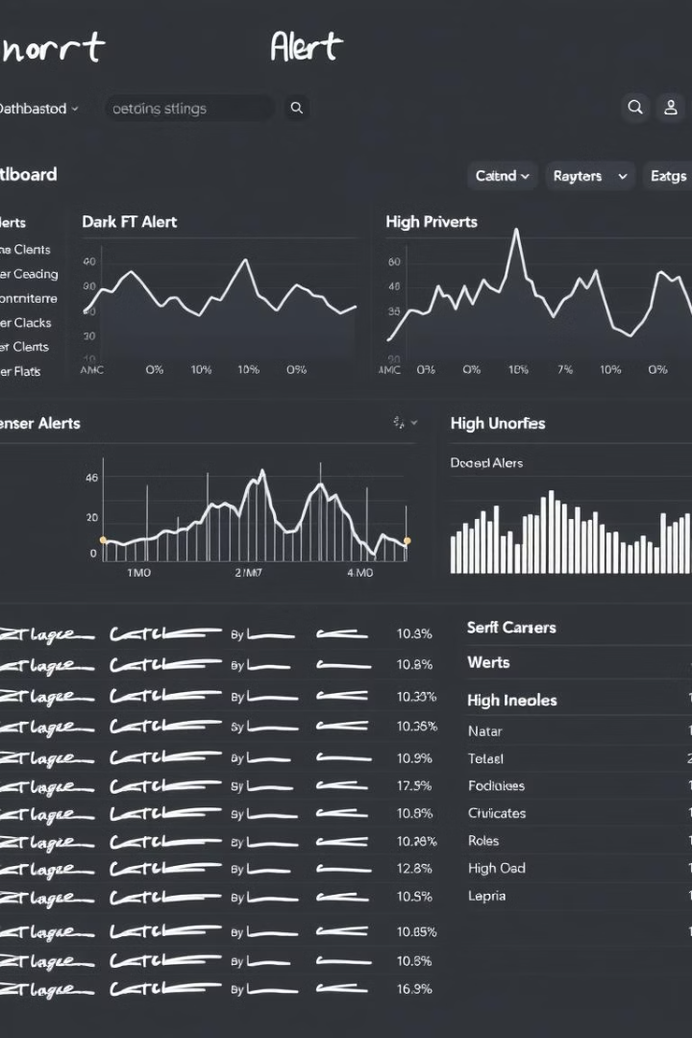
Snort Output Plugins: Logging and Alerting
Snort output plugins handle logging and alerting. Logging options include text files and databases. Alerting mechanisms include syslog, SNMP, and email.
Logging Options
Text files, databases.
Alerting Mechanisms
Syslog, SNMP, email.
SIEM Integration
Sending alerts to centralized systems.
Configuring Output
Choosing the right output method.

Slide 7



Real-World Snort Use Cases
Snort can be used to detect various types of attacks. These include port scans, malware infections, and web application attacks. It can also protect against DDoS attacks.
Detecting Port Scans
Detecting Malware
Protecting Against DDoS
Identifying reconnaissance activities.
Recognizing malicious traffic.
Recognizing and mitigating attacks.

Slide 8
Snort: Best Practices and Resources
Following best practices ensures effective intrusion detection with Snort. Rule management is crucial for keeping rules up-to-date. Performance tuning optimizes Snort's performance.
1
Rule Management
2
Performance Tuning
3
Community Resources
Utilize resources like Snort.org for assistance.

Slide 9

Thank you
Snort is a versatile tool. It can detect many kinds of threats. Regular updates and tuning ensure optimal performance. Using Snort can improve the security of your network.

